Slide 1
Assignment 1 Question 1
ER Diagram
Never Stand Still
Faculty of Engineering
Computer Science and Engineering

Slide 2
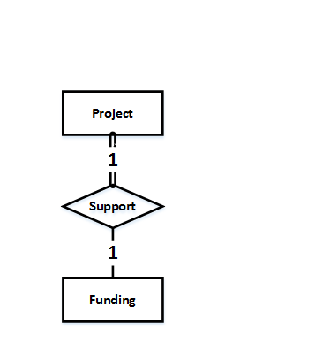
Research Project
Each research project has to be supported by a funding. A funding is uniquely identified by its ID, and we also need to know its amount.
For a research project, we also need to know the name, area, expected outcome, starting time and expected duration. A project may touch several different areas.

Slide 3
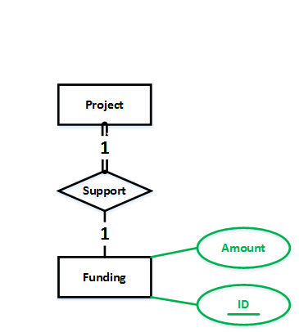
Research Project
Each research project has to be supported by a funding. A funding is uniquely identified by its ID, and we also need to know its amount.
For a research project, we also need to know the name, area, expected outcome, starting time and expected duration. A project may touch several different areas.

Slide 4
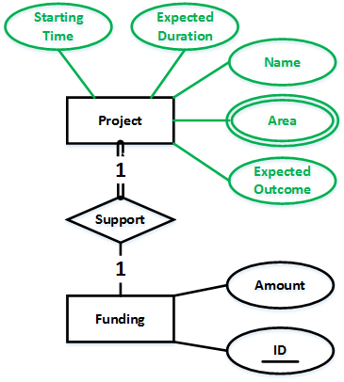
Research Project
Each research project has to be supported by a funding. A funding is uniquely identified by its ID, and we also need to know its amount.
For a research project, we also need to know the name, area, expected outcome, starting time and expected duration. A project may touch several different areas.

Slide 5
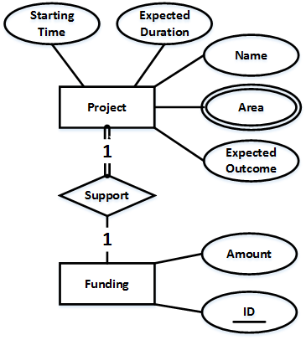
Research Project
Each research project has to be supported by a funding. A funding is uniquely identified by its ID, and we also need to know its amount.
For a research project, we also need to know the name, area, expected outcome, starting time and expected duration. A project may touch several different areas.
Question:
How can we uniquely identify Project?

Slide 6
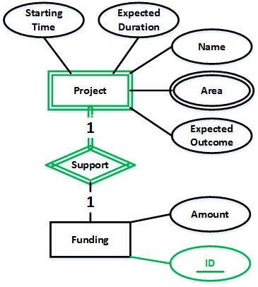
Research Project
Each research project has to be supported by a funding. A funding is uniquely identified by its ID, and we also need to know its amount.
For a research project, we also need to know the name, area, expected outcome, starting time and expected duration. A project may touch several different areas.
Question:
How can we uniquely identify Project?

Slide 7
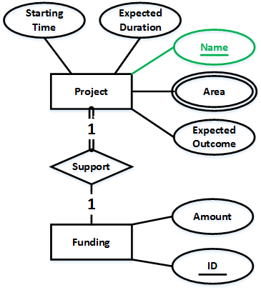
Research Project
Each research project has to be supported by a funding. A funding is uniquely identified by its ID, and we also need to know its amount.
For a research project, we also need to know the name, area, expected outcome, starting time and expected duration. A project may touch several different areas.
Question:
How can we uniquely identify Project?

Slide 8
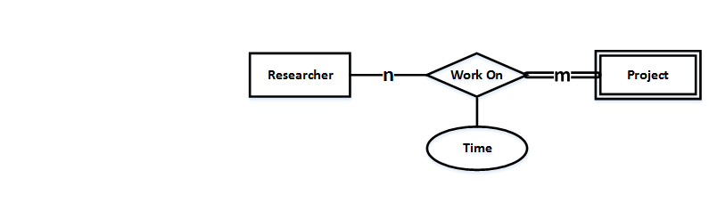
Researcher
A research project is carried out by several researchers, and a researcher can work on several research projects. The time a researcher works on a project is in need.
A researcher can be uniquely identified by his/her email. The total number of papers he/she has published is of interest, so as his/her address, which is composed of city and street.

Slide 9
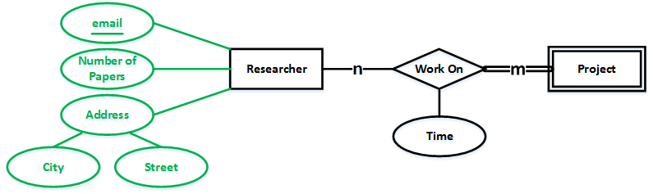
Researcher
A research project is carried out by several researchers, and a researcher can work on several research projects. The time a researcher works on a project is in need.
A researcher can be uniquely identified by his/her email. The total number of papers he/she has published is of interest, so as his/her address, which is composed of city and street.

Slide 10
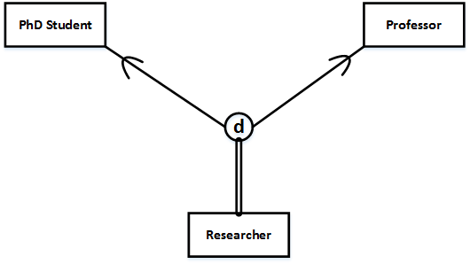
Researcher
A researcher can be either a Professor or a PhD student. A PhD student has to be supervised by exactly one professor. A professor can supervise multiple PhD students.
We need to know the year a PhD student started his/her PhD program.
We need to know the number of students a professor is supervising.

Slide 11
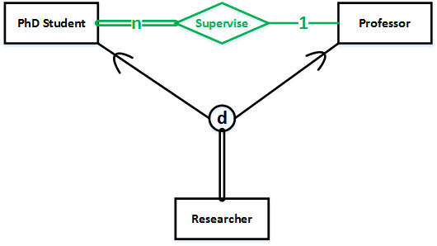
Researcher
A researcher can be either a Professor or a PhD student. A PhD student has to be supervised by exactly one professor. A professor can supervise multiple PhD students.
We need to know the year a PhD student started his/her PhD program.
We need to know the number of students a professor is supervising.

Slide 12
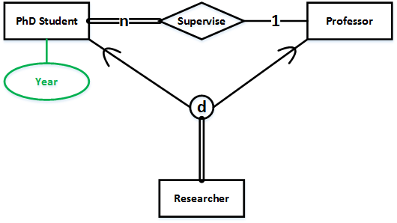
Researcher
A researcher can be either a Professor or a PhD student. A PhD student has to be supervised by exactly one professor. A professor can supervise multiple PhD students.
We need to know the year a PhD student started his/her PhD program.
We need to know the number of students a professor is supervising.

Slide 13
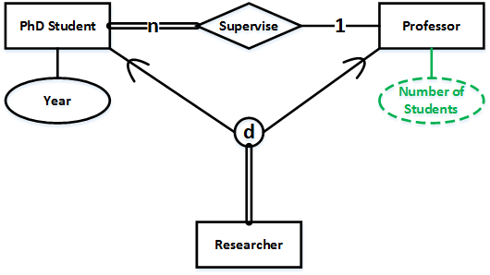
Researcher
A researcher can be either a Professor or a PhD student. A PhD student has to be supervised by exactly one professor. A professor can supervise multiple PhD students.
We need to know the year a PhD student started his/her PhD program.
We need to know the number of students a professor is supervising.

Slide 14
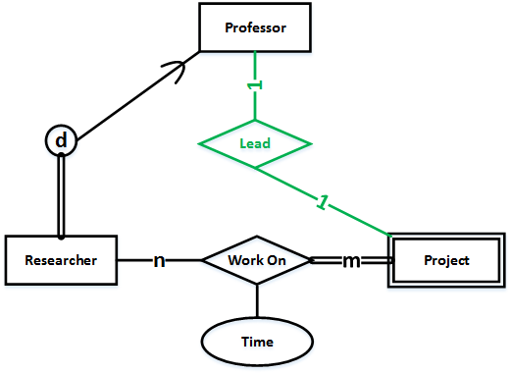
Professor – Lead – Research Project
A research project can have a leading professor, and a professor can lead at most one project.

Slide 15
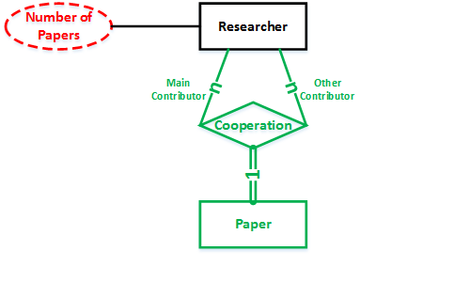
Paper
A paper must be the result of cooperation between several researchers.
A paper can be uniquely identified by its DOI. Also of interest are the title, publisher and date published.

Slide 16
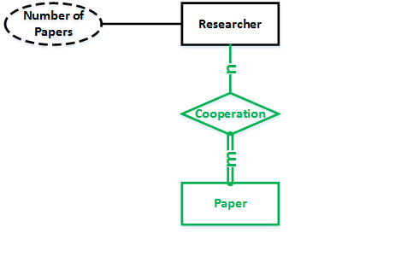
Paper
A paper must be the result of cooperation between several researchers.
A paper can be uniquely identified by its DOI. Also of interest are the title, publisher and date published.

Slide 17
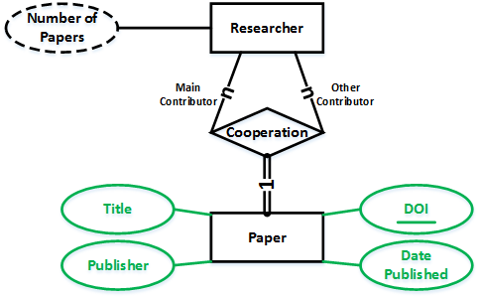
Paper
A paper must be the result of cooperation between several researchers.
A paper can be uniquely identified by its DOI. Also of interest are the title, publisher and date published.

Slide 18
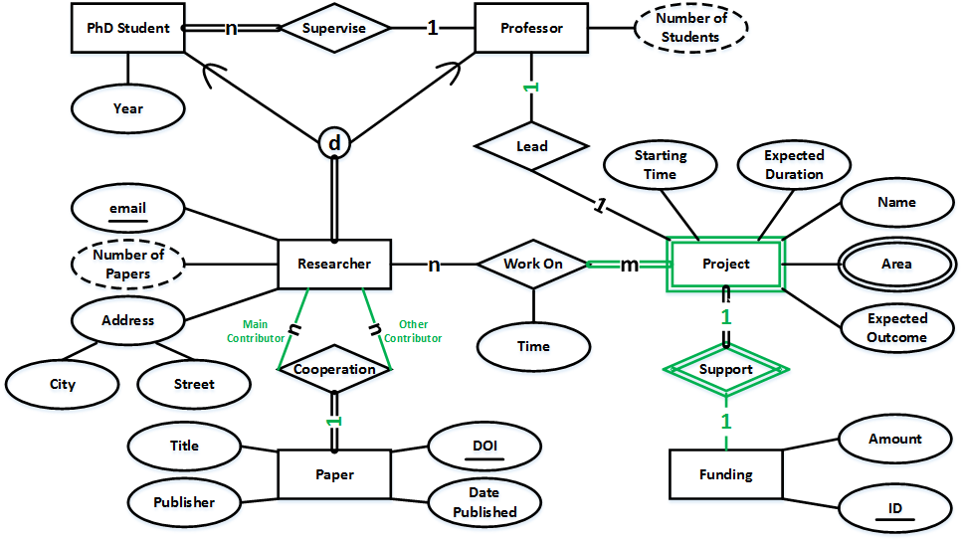
All Together Alternatives Exist with Different Interpretations and Assumptions

